Slide 1
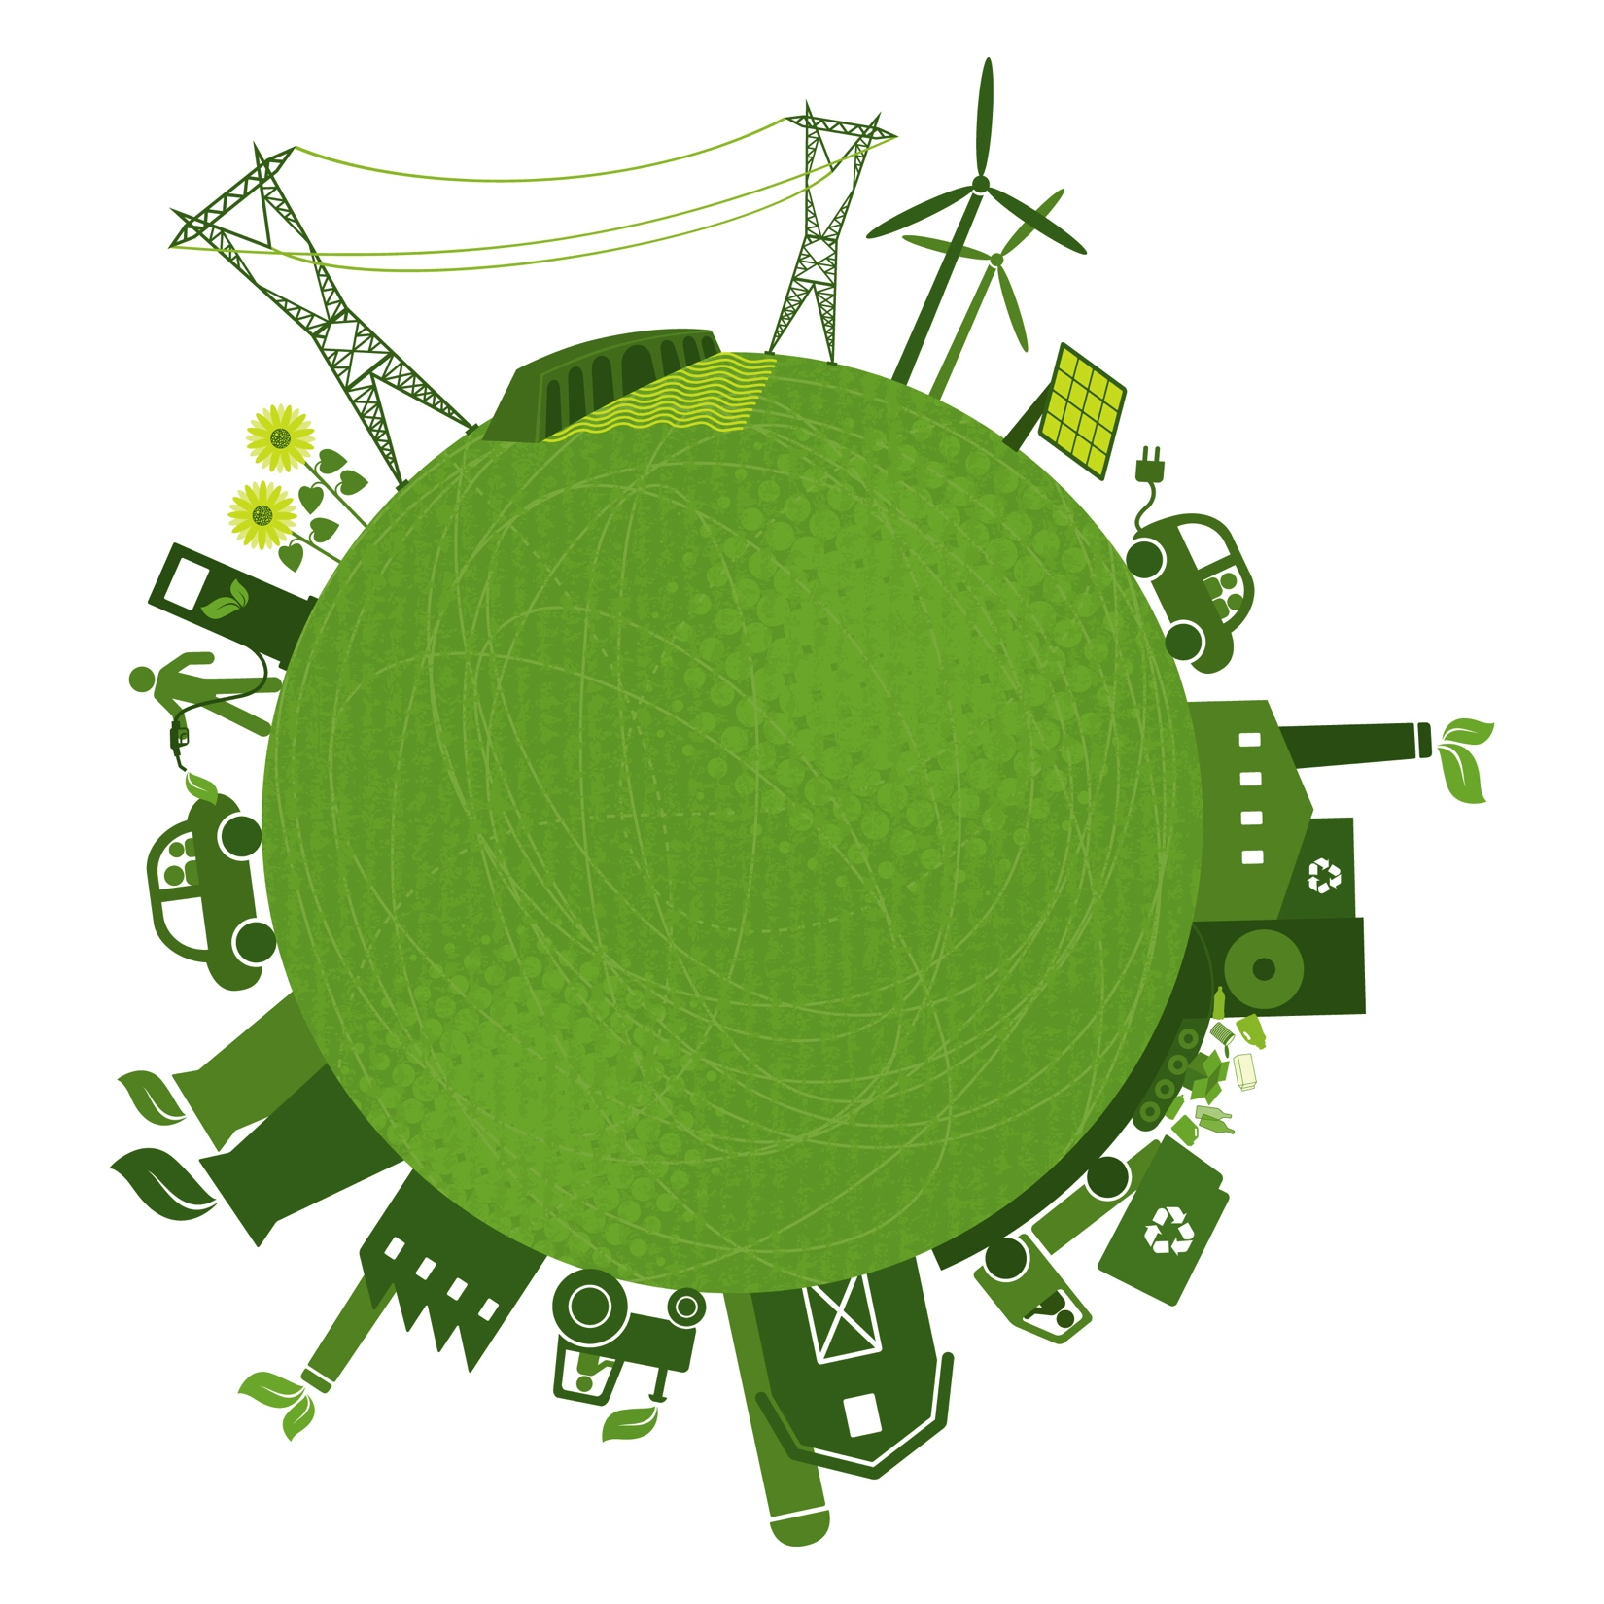
EMPIRE- modelling the future European power system under different climate policies
Asgeir Tomasgard, Christian Skar, Gerard Doorman, Bjørn H. Bakken, Ingeborg Graabak
FME CenSES
Centre for Sustainable Energy Studies

Slide 2
The transition to a sustainable power system
Challenge
The challenge for the energy system in years to come, is how to satisfy a continually growing global energy demand and at the same time reduce greenhouse gas (GHG) emissions.
Technology choices (examples)
Renewable energy
Energy efficiency and saving
Fuel substitution in transport
Carbon Capture and Sequestration
Policy instruments (examples)
Tax, e.g. a carbon price
Subsidies, e.g. a feed in tariff
Regulation, e.g. Emission Performance Standards

Slide 3
Purpose of our study
Evaluate the contribution of different policy scenarios on
Power markets and power demand
Generation expansion
Grid expansion
Emissions
In particular look at Norway´s role in the transition

Slide 4
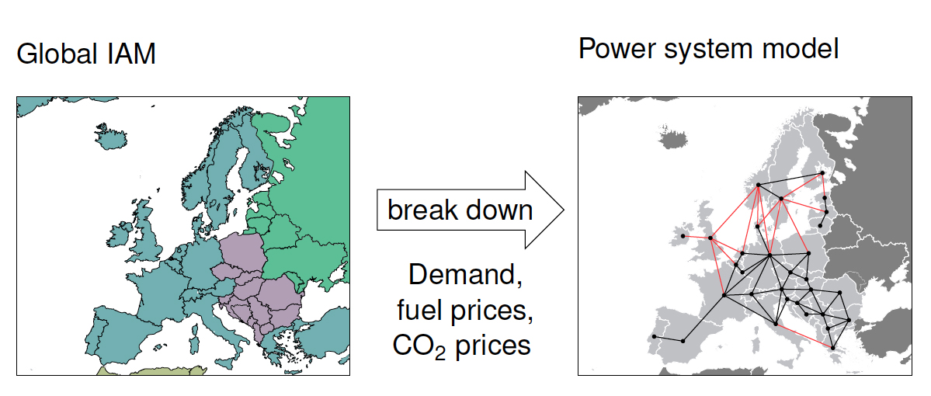



The team
The Ramona-EL
power system model

Slide 5
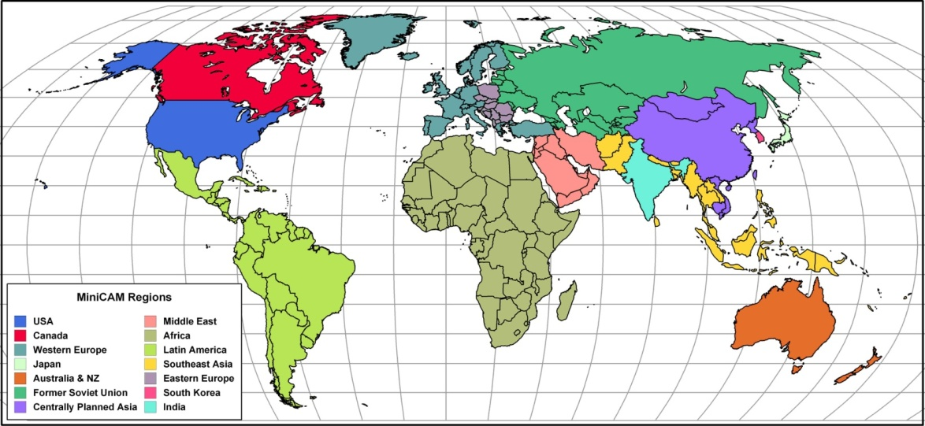
The GCAM tool
Technologically detailed integrated assessment model.
14 geopolitical regions
Emissions of 16 greenhouse gases
Runs through 2095 in 5-year time steps
Notes:
5

Slide 6
Ramona-EL
Power system design and operation
  Models each European country´s generation capacity and import/export channels, not physical lines
  Time horizon until 2050 – investments in 5 year steps
  Model operational time periods: demand, supply (stochastic wind and solar PV) and optimal dispatch.
Taking fuel prices, expected load and costs as input
Provides a cost minimization capacity expansion plan for Europe, detailed for each
country
  Load profiles from ENTSO-E and national data
  Inflow, wind and solar profiles from national data
  Costs, expected load and fuel prices from GCAM

Slide 7
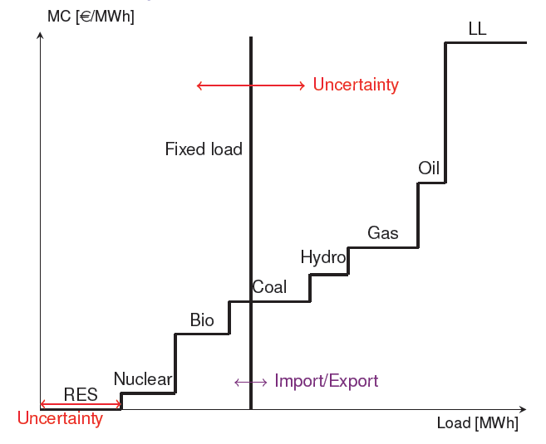
Hourly supply and demand
In total 4000 hours used to represent different dispatch situations over 50 years
4 seasons
24 hours sequences
Daily load patterns taken from 3 days per season + extreme days

Slide 8
Scenario descriptions
Global 202020 scenario – A policy scenario inspired by the European 20-20-20 targets.
  Renewable portfolio standards, energy efficiency improvements and share of bio fuel in the transportation sector are set for different regions across the world.
450 ppm stabilization scenario – A policy scenario where the atmospheric concentration of greenhouse gases is limited to 450 ppm CO₂-eq by the end of the century. Emission reduction is achieved by implementing a carbon price

Slide 9
European electricity demand

Slide 10
CO₂ prices

Slide 11
Installed capacity in power market 2050

Slide 12
The Ramona-EL analysis
Results for 2050
Global 202020 scenario
450 ppm stabilization scenario

Slide 13
Energy mix 202020

Slide 14
Energy mix 450

Slide 15
The need for flexibility
High variations in non-dispatchable renewable production from wind and solar PV
Global 202020: 21.4% non-dispatchable
450 ppm stabilization: 14,2 % non-dispatchable
Need flexibility and balancing
Seasonal
Weeks
Hourly
Shorter

Slide 16
New infrastructure in 2050 - 202020

Slide 17
New infrastructure 450

Slide 18
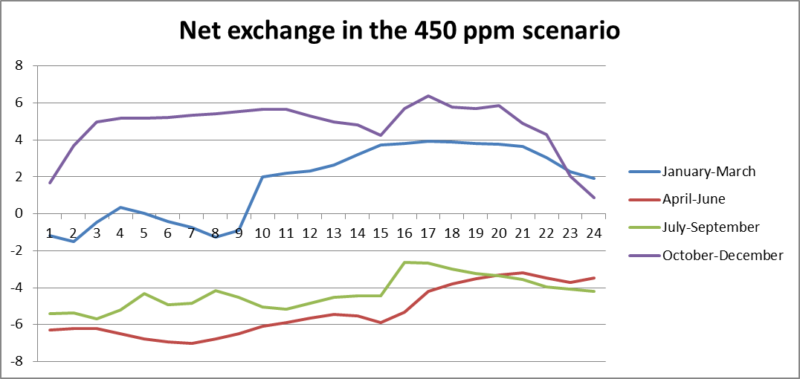
Example: Power exchange
European demand 4800TWh
Norwegian demand 162 TWh
New Norwegian cap. 20.1 GW
Net export 29 TWh
The exchange of power from Norway in 2050
European demand 5800 TWh
Norwegian demand 197 TWh
New Norwegian cap. 20.1 GW
Net import 7 TWh

Slide 19


Flexible Norwegian energy as a service to Europe I
Flexible
reservoir
Storage capacity of 85 TWh in the Norwegian reservoirs. This storage volume has most of the time at least 10-20 TWh free capacity
DC cable
Hydropower
plant
Line pack
Gas power plant

Slide 20
Example: Natural gas exchange
The possible inventory changes in a typical pipeline we looked at is in one hour approximately 9 GWh of electricity.

Slide 21
Flexible Norwegian energy as a service to Europe II
Flexible
reservoir
Storage using linepack in gas pipelines:
Flexibility of 2% within the hour, and 15% in 12 hours. For the given pipeline, this means that the inventory could be changed with approximately 134 GWh within 12 hours.
DC cable
Hydropower
plant
Line pack
Gas power plant

