Slide 1
MultiMOD – An equilibrium model for energy market & infrastructure analysis
Ruud Egging
24th Oct 2013
CREE meets CenSES
Notes:
Credit: http://www.wpclipart.com/terms.html

Slide 2
Research Objectives
Analyze trends in, and policy impact on energy markets, infrastructure developments and GHG emissions
What-if analysis
scenario/policy assumptions
impact on production, consumption, trade, infrastructure, fuel mix in power generation, GHG emissions, ….

Slide 3
Research ambition
Integrated model, capturing all relevant energy market interactions in single model
fuel substitution
infrastructure developments
market power aspects
renewables integration
climate policy
Load & Seasonal variations
Carbon leakage through goods trade
Uncertainty

Slide 4
Model actors overview
Suppliers
“produce” and sell fuels and other energy carriers
may be Cournot players vis-à-vis final demand
Arc operators
allocate possibly congested transmission capacity, e.g., pipelines, LNG shipping, power lines, …
Transformation technology operators
allocate transformation capacity of fuels, e.g, oil refineries, power plants
technologies can include restrictions of certain input fuels relative to total output, e.g. mandate to add bio-fuel at a refinery

Slide 5
Model actors overview continued
Storage operators
allow suppliers to shift fuels over seasons/hours
Emission permit auctioneer
allocates permits for various pollutants and green-house gases
global, regional or nodal level
emission trading and emission taxes
Final demand for energy
linear inverse demand curve by sector.
Linear substitution between different fuels
fuel-specific (non-constant) efficiencies and end use costs.
Restrictions on fuel mix and generation mix by sector and fuel can be included to represent regulation or technical constraints.

Slide 6
Trade & supply relations illustration
Country A
Country B
Gas
Oil
Uranium
Coal
Solar/Wind
Gas
Biomass
Biomass
Power Generation
Refining/ Transformation
Power Generation
Refining/ Transformation
Transportation
Transportation
Residential/Commercial
Industry
Residential/Commercial
Industry

Slide 7
Key actor: supplier
Supplier decides
production
trade (how much transport cap to use)
transformation (refining & power generation(!))
how much of what fuel/energy carrier to sell to demand sectors in each node
…

Slide 8
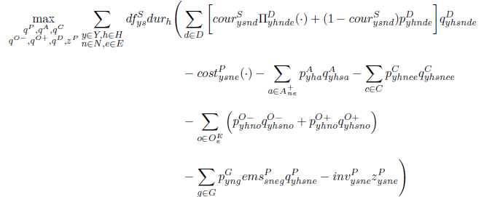
Supplier objective

Slide 9
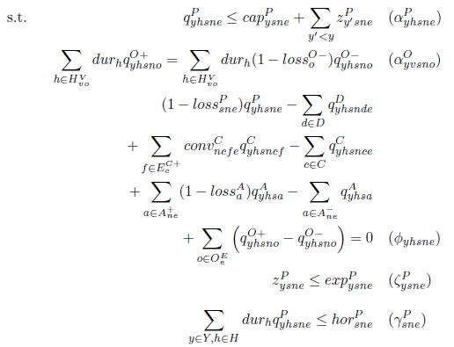
Supplier constraints

Slide 10
Transmission System ('Arc') Operator

Slide 11
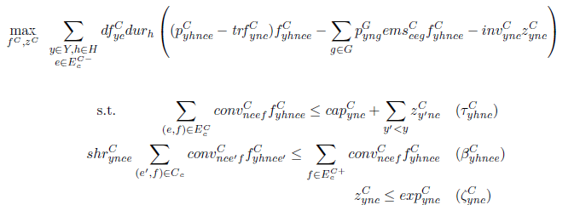
Transformation technology operator

Slide 12
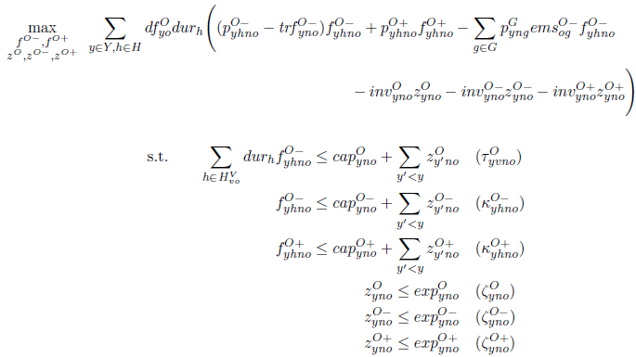
Storage operator

Slide 13
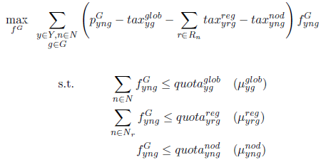
Emission Permit Auctioneer

Slide 14
Final demand

Slide 15
KKT's plus market clearing conditions→ MCP

Slide 16
illustrations

Slide 17
Data inputs
Production, consumption, transport, storage
Costs, capacities, efficiencies, loss rates, prices
No own forecasting, but calibrate models to reflect production & consumption in base year and forecasts from IEA, EIA, …
We add: country/infrastructure detail, market power assumptions, …

Slide 18
Cases 'Focus on Germany'
Germany has announced an EnergieWende
Phasing out nuclear power
Full speed ahead with renewable energy
Recently, a major gas pipeline from Russia has been constructed.
Can Norway be a "Green Battery"?
What is impact on German energy market?

Slide 19
German Energy context
Main European energy suppliers

Slide 20
Germany
Nuclear phase out
Renewables plus 50%
Nord Stream I
Green battery Norway?
X

Slide 21
German Supply Mix Power Generation (Mtoe after conversion)
Notes:
*This Figure shows
*Phase Out: base load, imports
*Nord Stream: gas peak load, allows more base load, higher exports
*No-hydro Renew + 50%: push out coal (base load)
*NOR green batt: GER exports less
*Combi:

Slide 22
Role of Norway..
Germany actually exports in reference case
In case studies Norway export only moderate amounts to Germany
But, what is missing in this model which might trigger much more trade between the two countries?

Slide 23
CO2 tax EU-ETS

Slide 24
Regional CO2 tax: Carbon Leakage?
What if Europe imposes a tax on CO2 emissions, and other regions don't?
Reduction in Europe partly undone due imports: carbon leakage
Should consider energy use for goods production..
Effects in energy-only model?

Slide 25
CO₂ emissions ref 2010 (tax $20/ton)
3.8 Gt
3.8 + 26.8 = 30.6 Gt
Giga ton = 10³ bln kg
Notes:
EU-ETS (REF = 3,800 Mton)
WORLD (REF = 30,600 Mton)
1274 is 33 % of EU-ETS reference emissions
1274 is 4.2 % of global reference emissions
825 is 2.7 % of global reference emissions

Slide 26
ETS CO₂ tax $60/ton
-548 Mt ( -14%)
- 548 + 256 = -292
Carbon leakage: 47%
Notes:
EU-ETS (REF = 3,800 Mton)
WORLD (REF = 30,600 Mton)
1274 is 33 % of EU-ETS reference emissions
1274 is 4.2 % of global reference emissions
825 is 2.7 % of global reference emissions

Slide 27
ETS CO₂ tax $100/ton
-1274 Mt ( -34%)
- 1274 + 449 = -825
Carbon Leakage: 35%
Notes:
EU-ETS (REF = 3,800 Mton)
WORLD (REF = 30,600 Mton)
1274 is 33 % of EU-ETS reference emissions
1274 is 4.2 % of global reference emissions
825 is 2.7 % of global reference emissions

Slide 28
CO₂-emission reductions and leakage for various EU-ETS tax levels
Notes:
*This graph shows
*The upper bars effective reduction
*Lower bars: part of ETS reduction compensated by additional in RoW
*Low tax: more than half
*Higher tax:
*Note $100 → 1/3 reduction ETS
EU-ETS (REF = 3,800 Mton)
WORLD (REF = 30,600 Mton)
1274 is 33 % of EU-ETS reference emissions
1274 is 4.2 % of global reference emissions
825 is 2.7 % of global reference emissions

Slide 29
ongoing research

Slide 30
Work in progress
Multi-period: endogenous capacity expansions
seasonality: demand variation and storage
supply load curves: renewables intermittency
Representing energy-intensive goods (CO₂ leakage)
Master students:
DIW: two finished: projections 2020
Policy instruments in the European market
Investment risk related to shale gas in Europe
Decomposition
PhD Sophie: Uncertainty & multi-horizon scenario trees

Slide 31
GEMSTONE/MultiMod
Insight in energy markets
Notes:
Credit: http://commons.wikimedia.org/wiki/Category:Maps_of_the_world
Global Energy Market Model for Sustainability, Technology Options and Network Expansion.
"Equilibrium models for energy market and infrastructure analysis"
In this presentation I will discuss some of the problems and research objectives related to energy markets and infrastructure developments. I will clarify the limitations of optimization models for this type of research, and illustrate the use of equilibrium models (cast as mixed complementarity problems) and some insights that we can obtain when using such models.

Slide 32
Credits
Green-blue globe:
http://www.wpclipart.com/terms.html
World map:
http://commons.wikimedia.org/wiki/Category:Maps_of_the_world

