Slide 1
RegPol
Model links and integration
Modellforum CREE-CenSES 24. oktober 2013
Per Ivar Helgesen

Slide 2
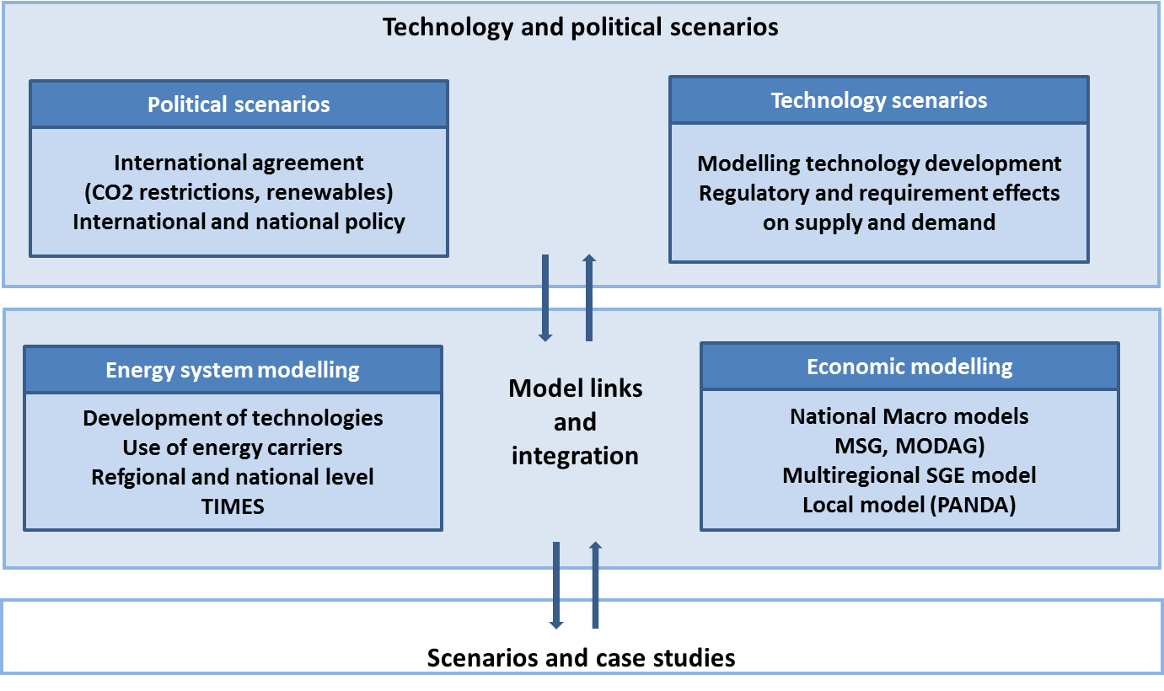


Project structure
Development of technologies
Use of energy carriers
Regional and national level
TIMES
National Macro models
(MSG, MODAG)
Multiregional SCGE model
Local model (PANDA)

Slide 3

Linking - Top down

Slide 4

Bottom up

Slide 5
Top down models
Economics
High level of abstraction
The economy as a whole
Bottom up
Engineering
Technology rich
Physical laws of nature

Slide 6
Top-down models
Describe the interaction between the energy system and the econcomy as a whole
Do not contain technological detail, representing the energy sector in aggregate form
Bottom-up models
Represent the energy system with great detail
Ignore the full macroeconomic feedbacks of different energy system pathways
Notes:
Policy makers need clear and consistent information concerning the real impact of policies in the economy and the most cost-efficient technology portfolio.

Slide 7
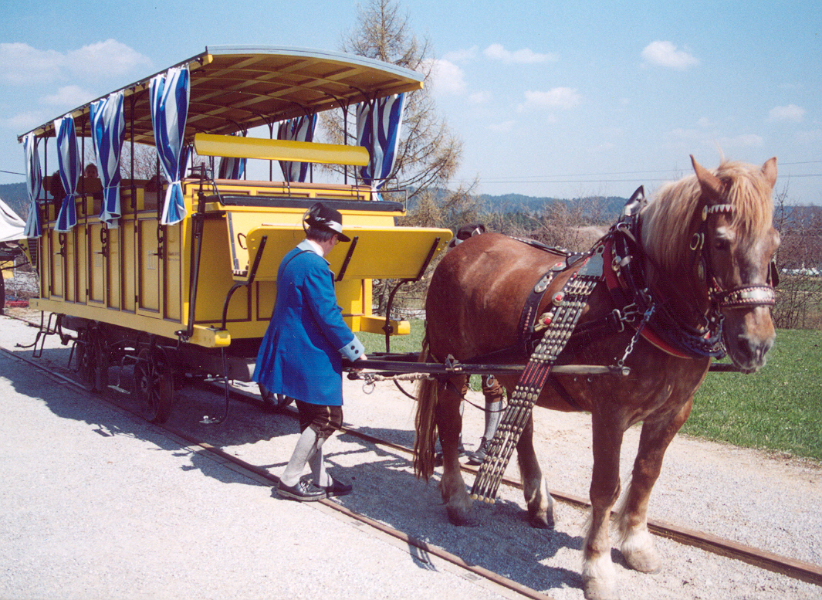
Hybrid…
Foto: Stanislav Jelen

Slide 8
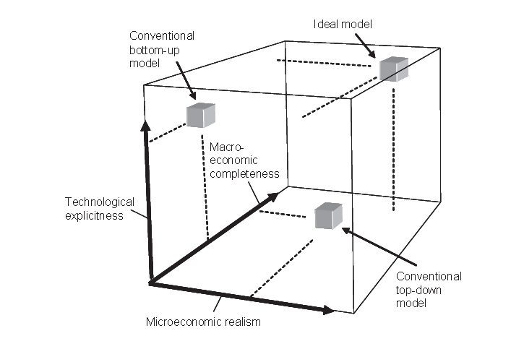
Hybrid modeling (Hourcade et al 2006)
Notes:
Ordet HYBRID – blanding mellom ulik arter (f.eks ulv+hund, muldyr=hest+esel). I jordbruket lager man hybrider for å få større avlinger. Hybrid-biler er en blanding ved at den f.eks har både el og bensin.

Slide 9
MSG-TECH
Hybrid model
Bygget på den generelle likevektsmodellen MSG6
Representerer teknologiske muligheter ut over dem som eksisterer i dag, slik som energisystemmodeller

Slide 10
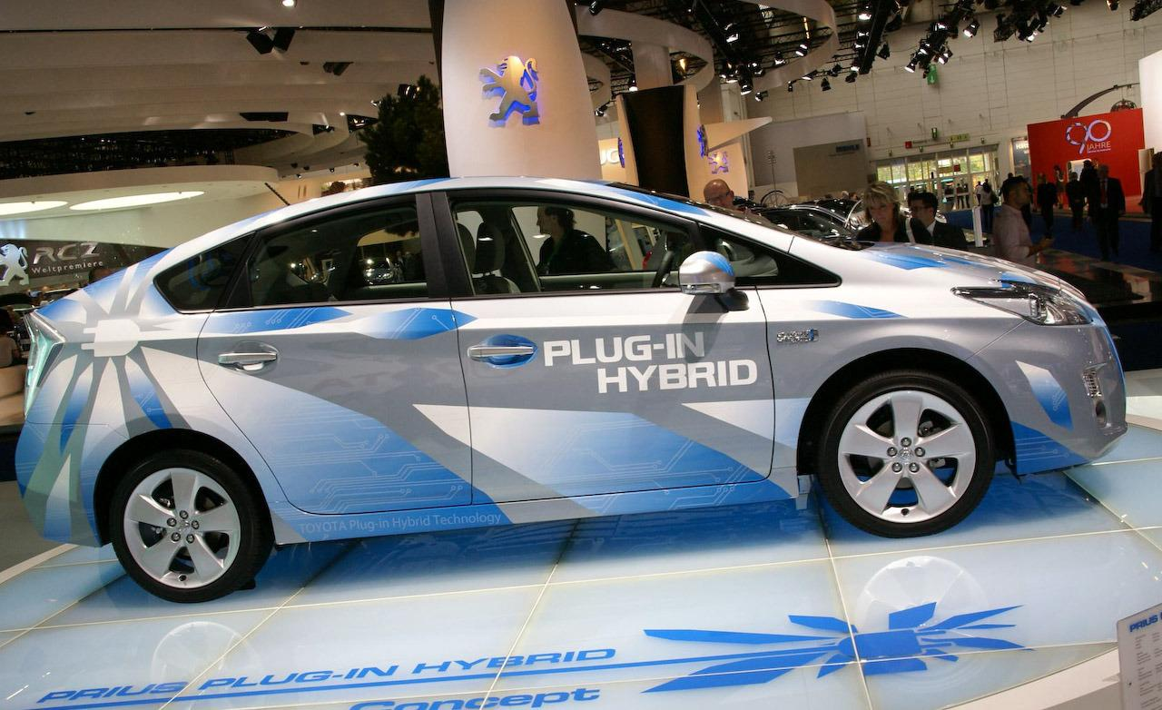

Slide 11
Different types of linking
Separate models
Soft linked models
Hard linked models (automated data exchange)
Integrated model

Slide 12
Integration possible?
TIMES
CGE
Linear program
Complementarity

Slide 13




The Bigger Picture
Complementarity Problems
KKT conditions
NLP
Other non-optimization based problems
e.g.
spatial price equilibria, traffic equilibria,
Nash-Cournot games
LP
convex
QP
Source: Prof. Steven Gabriel

Slide 14
Separate models
Top-down and bottom-up models
Hybrid models
Top-down CGE and
bottom-up optimisation
models linked
Modular hybrid models
Integrated model
Complementarity problem

Slide 15
Research question
Will linked models and an integrated model produce the same solutions?
Which conditions must be fulfilled?

Slide 16
What's the point?
These are different models that complements each others
By linking the models, both should improve their accuracy – and the existing expertise is better utilised
Linking the models provides a richer hybrid model for analysis – which consequently should lead to improved decisions and decision support
The linked models calculates other results than the individual models do
It could be easier to manage the expertise by linking the (stand-alone) models instead of integrating them. It is probably easier to test and develop the models separately.

Slide 17
How to do it?

Slide 18
Translation
Separate models
Soft linked models
Hard linked models (automated data exchange)
Integrated model
Physical flows Monetary values

Slide 19
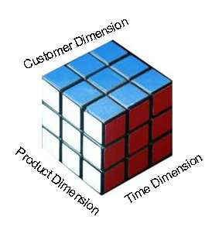
Model dimensions
Industries
Time
Regions

Slide 20
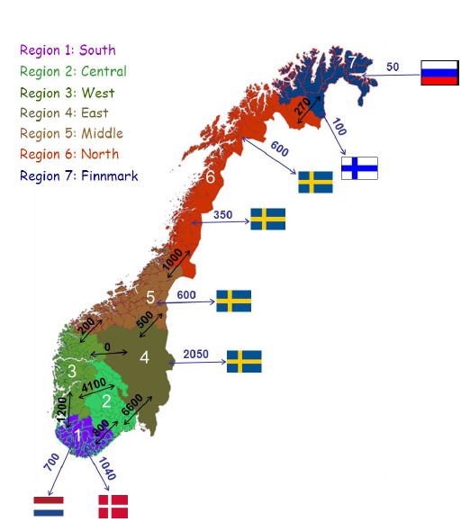
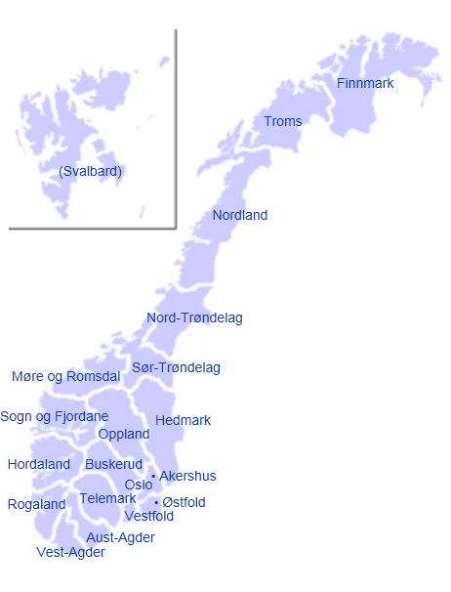
Subnational regions in Norway
TIMES Norway
Regional accounts statistics
Notes:
The national accounts are consolidated into regional accounts

Slide 21
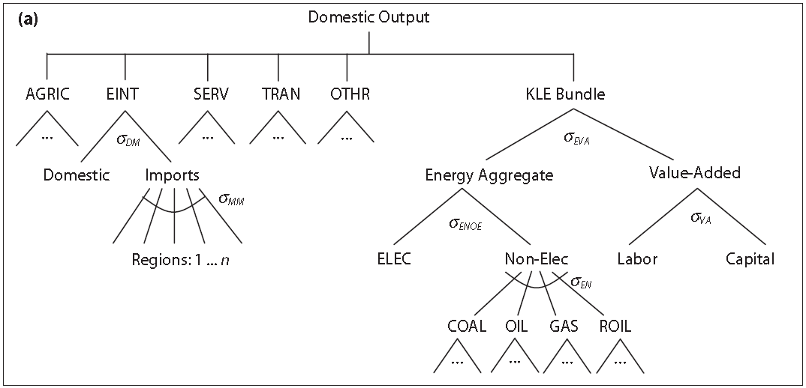
Matcing industries in the models
Services, industries and industrial transportation
TIMES Norway demand sectors
Sector | # sub-sectors | Demand type | # demand data per region | Sum # demand data
Industry | 11-14 | Electricity, heat, raw material | 33-42 | 231-240
Households | 5 | Electricity, heat | 10 | 70
Tertiary | 8 | Electricity, heating, cooling | 21 | 147
Primary | - | Electricity, heat, raw material | 3 | 21
Transport | 8 | Vehicle-km, tonne-km, useful energy demand | 8 | 56
Total | 33-36 |  | 75-78 | 534

Slide 22
Time dimension – granularity
TIMES-Norway
  Day/night, weekend, seasons
  260 timeslices (52*5)
  Dynamic model
  Perfect foresight
CGE-models
  Yearly numbers from national accounts
  Often static models
  Dynamic recursive, intertemporal paths between equilibria

Slide 23
Time dimension – using a static CGE
2050
2050
2050
2050
2050
2050
…
2040
2040
2040
2030
2030
2030
2020
2020
2020
2010
2010
2010
Energy-
systems
model
Equilibrium
Energy-
systems
model
Equilibrium
model
Energy-
systems
model
Equilibrium
model
Energy-
systems
model
Equilibrium
model
Energy-
systems
model
Equilibrium
model
model

Slide 24
To do…
TIMES
SCGE
CGE
Linking
"Spatial" versus "multiregional"
→ Introduction of New Economic Geography (NEG) elements, such as
  increasing returns to scale
  transport costs
  labor mobility
Notes:
Regional dimensjon er ikke modellert
Regional imbalances will appear and people will need to move geographically as well as between sectors.

Slide 25
Experiences
Linked models | From energy systems model | From macroeconomic model | Link type
MARKAL-MACRO (1992) | Energy costs | Energy demand | Hard
MARKAL – MSG (1996) | Energy mix | Energy demand (useful energy) | Soft
MARKAL – MSG (2011) | Energy mix Electricity price. | Energy demand (energy services) Initial electricity production. | Soft
MARKAL – MSG (2012) | Technology choices | Production and consumption quantities. | Soft
MESSAGE–MACRO (1996) | Prices (total and marginal) | Energy demand | Soft
MESSAGE–MACRO (2000) | Energy shadow prices Energy demand Total energy system cost | Demand curves for electric and non-electric energy | Hard
MARKAL –EPPA (2005) | Adjustment of CES elasticities and AEEI | Prices, taxes and transport demand | Soft
TIMES – EMEC (2012) | Energy mix (to Leontief functions) | Energy demand (converted from monetary units) | Soft

Slide 26
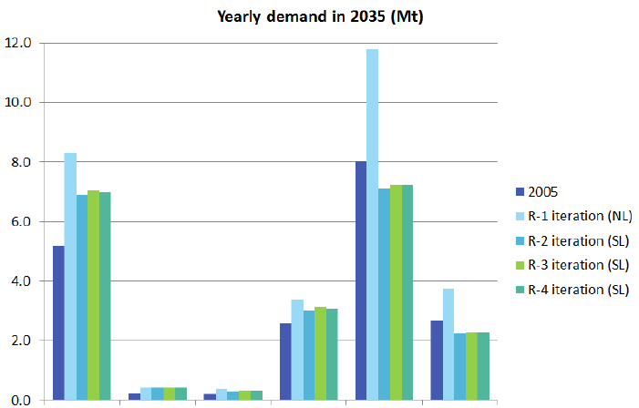
Iterations and convergence - Oscillations
(TIMES EMEC 2012)
Iron&Steel Aluminum Copper Cement Paper Paper
hi quality low quality

Slide 27


Ongoing projects linking TIMES and CGE
Portugal: HybTEP
Danmark: IntERACT

Slide 28
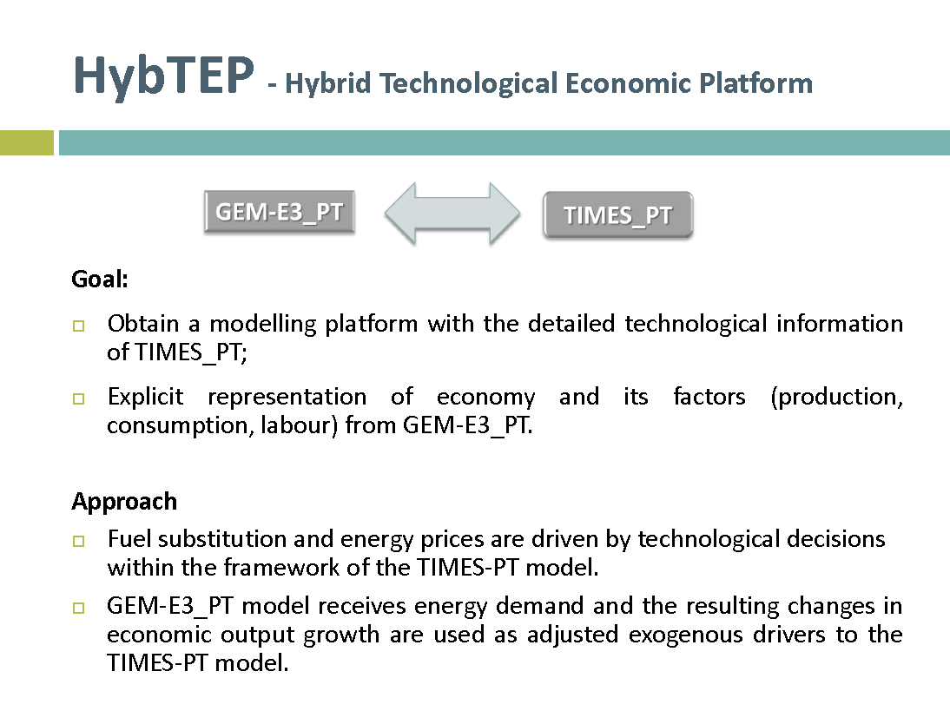

Slide 29
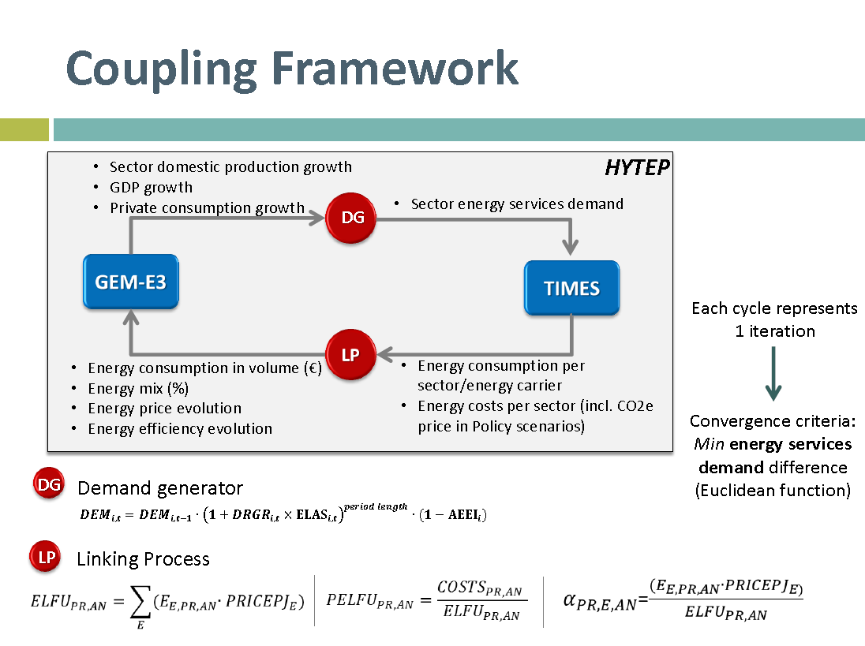

Slide 30
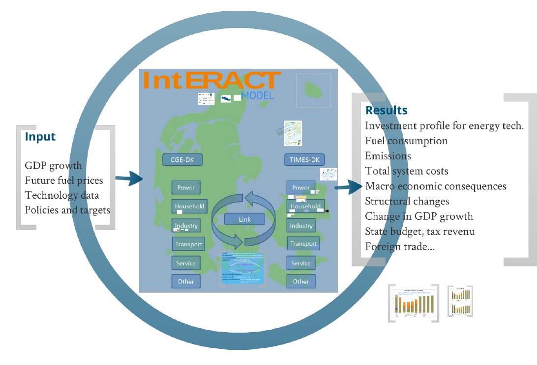

Slide 31
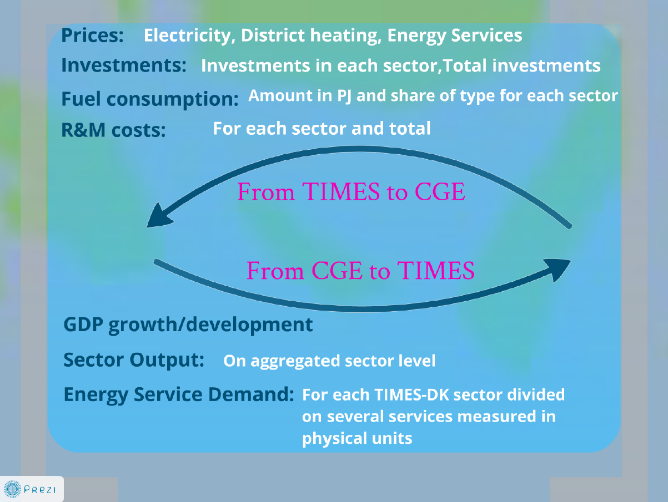

Slide 32
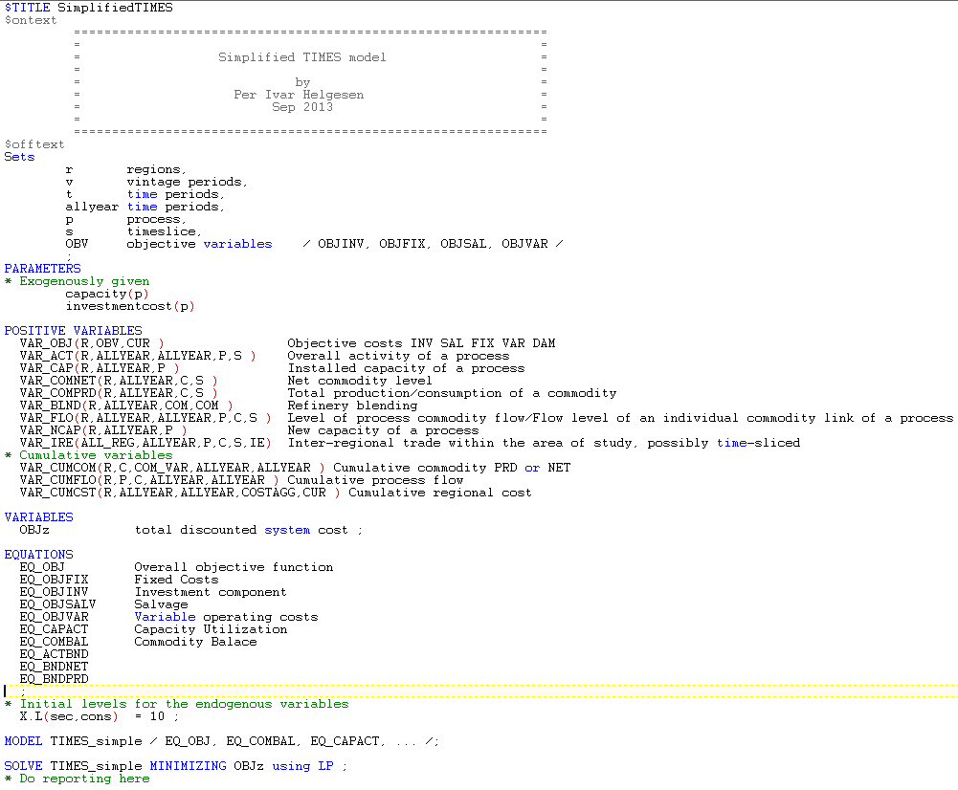
TIMES in GAMS

Slide 33
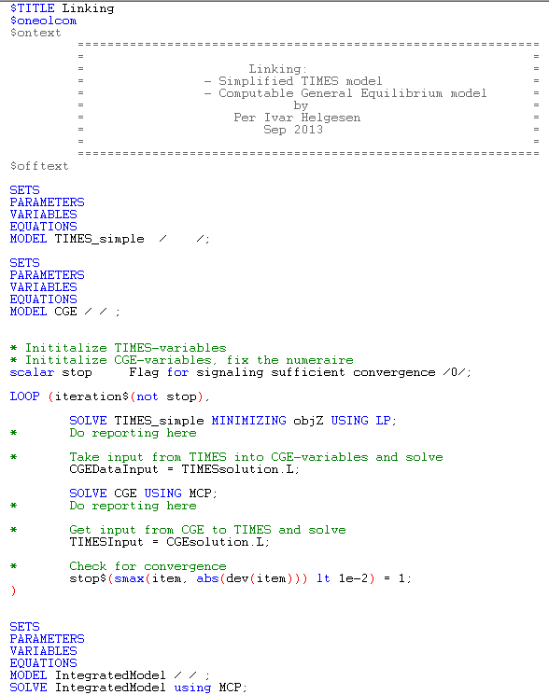
Linking the models

Slide 34

Thank you for your attention
per.ivar.helgesen@enova.no

