Slide 1
The future renewable fuel – production of 2nd generation Biofuel
CREE meeting, Dec 8, 2016

Slide 2
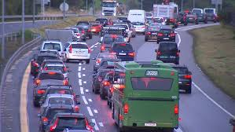
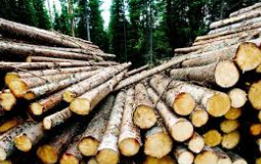
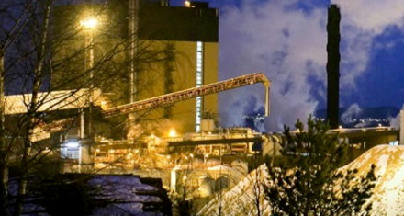
Drivers supporting biofuel
Role of transport in climate policies
Development of biofuel could contribute to Norwegian climate targets
Transport sector key to Norway’s green shift - electrification and bio
Norway will join EUs framework for climate targets 2030
EU commitment to 30 % reduction target for non-ETS-sectors
Will make use of resources
Norwegian industrial use of forest feedstock drastically reduced
Large unexploited volume with industrial potential
Closure of P&P mills impacts the whole forest industry
Negative ripple effects on local employment and competence
More innovative and green industry
Develop commercial production of 2.generation biofuel in Norway
Green shift in Norwegian industry
Reduced petroleum investments
Important to improve competitiveness in non-petroleum sector
Need for innovation and technology development

Slide 3
What has been done?
Evaluated 30+ technologies – all are in development phase with pilot plant scale
Working with short-list of technology vendors since 2015
Completed Basic Design studies
Produced several hundred litres of fuel product
Performed fuel analysis and upgrading tests
Key risk factor will be technology scale-up
Propose to mitigate risk by building Demo plant as a scaled-down Commercial plant

Slide 4
Ambition: Commercial Plant Decided in 2020
Production of 2nd generation biofuel for transportation
Forest feedstock volumes ~800 odt/d
Production of ~100 mill litres fuel/year
Located at Tofte
Developed and operated by Silva
End-product focus blend-in biodiesel

Slide 5
Opportunity is there
Sustainable forest is the best natural resource for 2G Biofuels
Total Liquid market
Mill. liter
9000
Economically available potential: 4 million m³ /year
Renewable fuels: 600 million l/year
Annual CO₂ capture: 1.5 million t/year
Total Liquid Market
6500
Transport
Non-Road
4200
Road
Gasoline
2900
Diesel
Light Duty
Heavy-Duty
Market Volumes

Slide 6
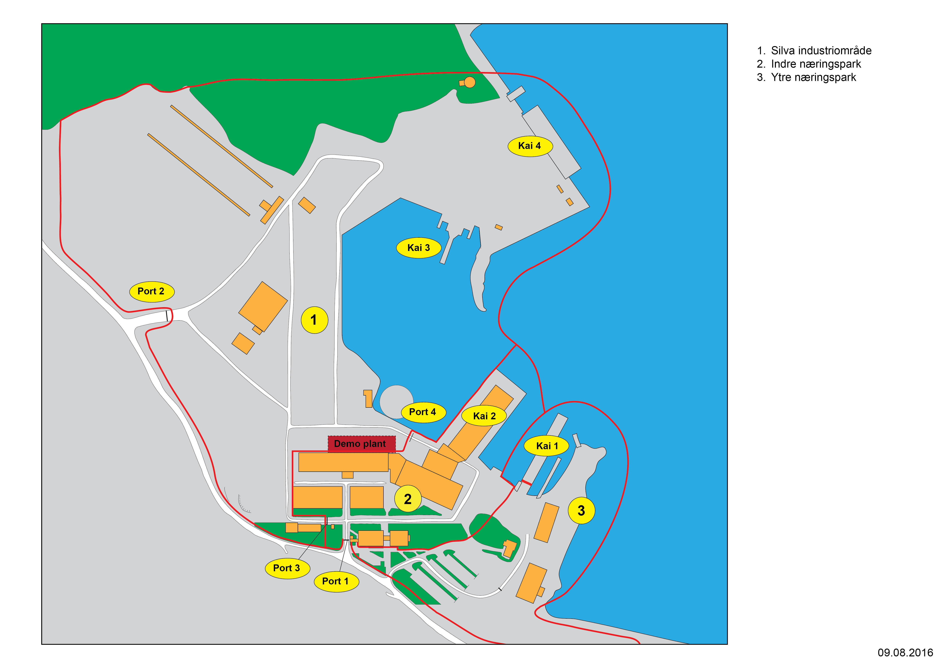
Demo Plant Location

Slide 7
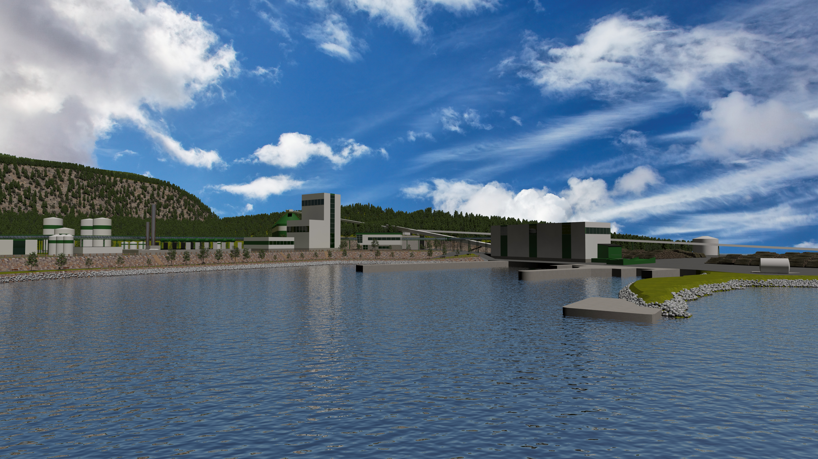
Rendering of Commercial Plant

