Slide 1
Nuclear energy in Europe in Statoil’s Energy Perspectives 2014

Slide 2
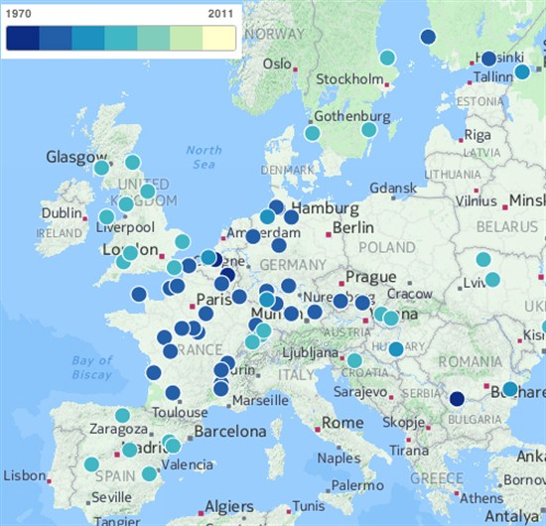
Nuclear in Europe: The characteristics of a sunset industry?
Europe’s nuclear power plant fleet is ageing
European nuclear power generation has dropped off in relative and absolute terms
Relative terms: Peaked at 31% of total power generation in 1993, consistently above 30% for remainder of ‘90s, but 24% in 2012 (IEA)
Absolute terms: Peaked at 998 TWh in 2004, down 11.8% to 881 TWh in 2012 (IEA)
A sunset industry?
Unless and until new plant construction gains speed, it could be marginalized during the 2020s
Capacity losses if plants are shut down at 40
Source: Carbonbrief using CartoDB from Guardian

Slide 3
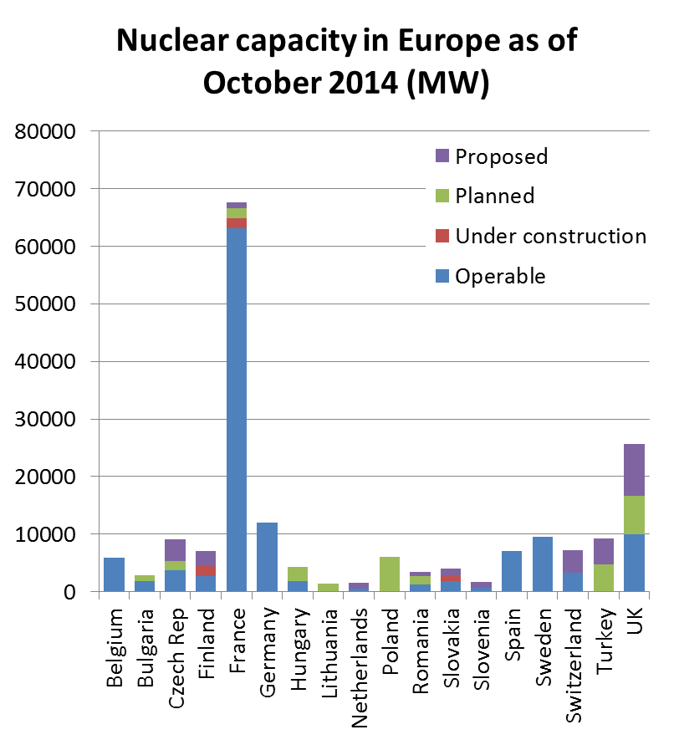
Current activity levels do not promise a rebound
23 new reactors at the planning stage and 24 proposed (against 136 in operation – but only four reactors under construction
Two in Slovakia, one in France and one in Finland
Only Poland, Turkey and the UK have signalled unambiguous confidence in nuclear and plan significant expansion…
…and political interest needs in most cases to be backed up by regulatory and fiscal framework conditions making private investors willing to play along
Source: World Nuclear Association

Slide 4
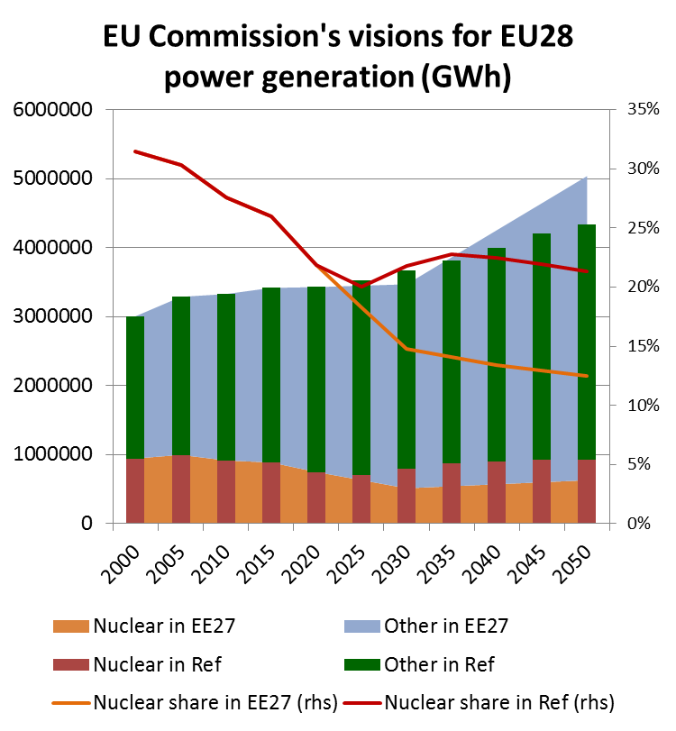
EU’s newest visions offer limited support
EU Commission envisages in its Reference scenario a 20% decline in nuclear power between 2015 and 2025 but a recovery in both absolute and relative terms between 2025 and 2035
In the Commission’s 27% energy efficiency improvement scenario, total power generation increases much faster but nuclear is displaced and captures a market share of only 12.5% by 2050
Sources: EU Commission: EU Energy, Transport and GHG Emissions Trends to 2050; US DOE EIA: EU Commission: Impact assessment accompanying the document «Energy Efficiency and its contributions to energy security and the 2030 framework for climate and energy policy»

Slide 5
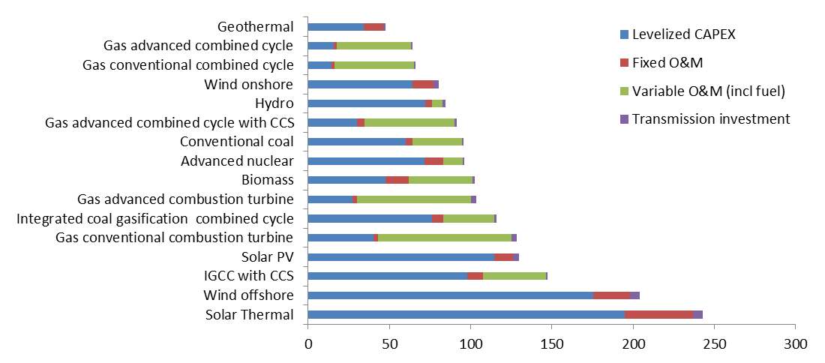
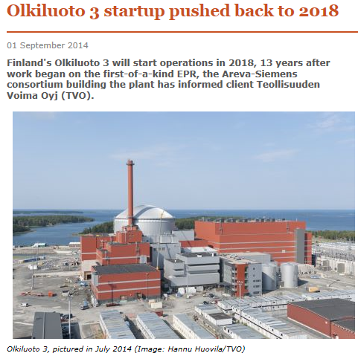
At the end of the day, commercial interest in nuclear will set the pace
Estimated levelized cost of electricity for new generation resources, 2019 (2012-$/MWh): Nuclear apparently competitive…
…but LCOE estimates may be a poor guide to viability
92%
Assumed capacity factors
87%
87%
35%
53%
87%
85%
90%
83%
30%
85%
30%
25%
85%
37%
20%
Source: US DOE EIA: Annual Energy Outlook 2014

Slide 6
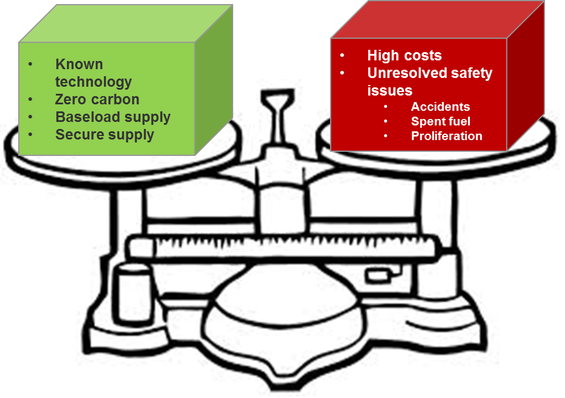
In Statoil’s Reference scenario, the pros of nuclear gradually resurface
Statoil’s Reference scenario assumptions:
The global warming threat will continue to shape attitudes and policy, constraining coal power generation
Intermittent power generation will increase in absolute and relative terms…
…but the cost declines that have supported the progress for solar PV and onshore wind power will abate…
… and system costs will mount
Hence decarbonization of the power sector by means of these technologies alone will be a tall order
Streamlining of regulatory provisions and standardization of 3rd generation nuclear technology will reduce cost overruns
No more Chernobyls or Fukushimas!
=> After a decline in European nuclear power generation in absolute and relative terms, the late 2020s and 2030s will see a modest resurgence
Nuclear power
The pros… …and the cons

Slide 7
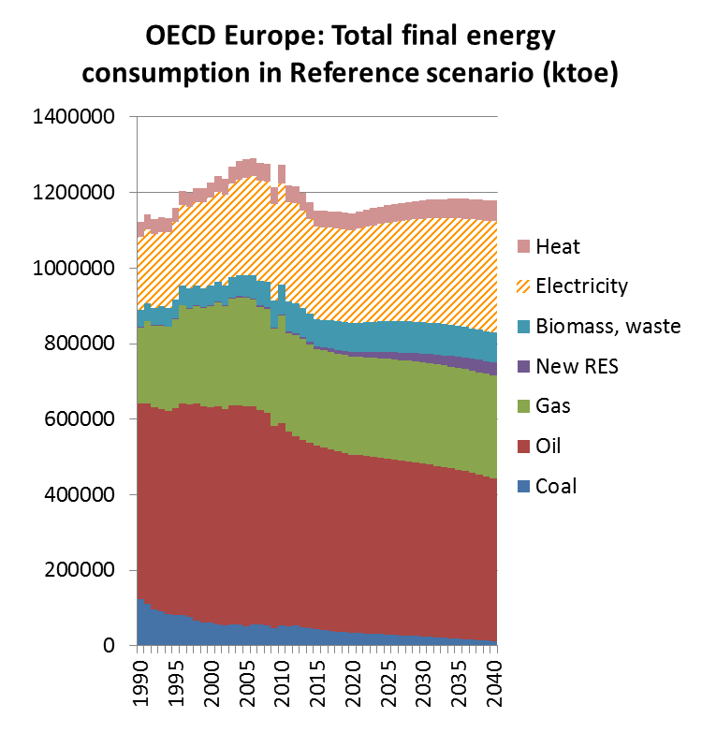
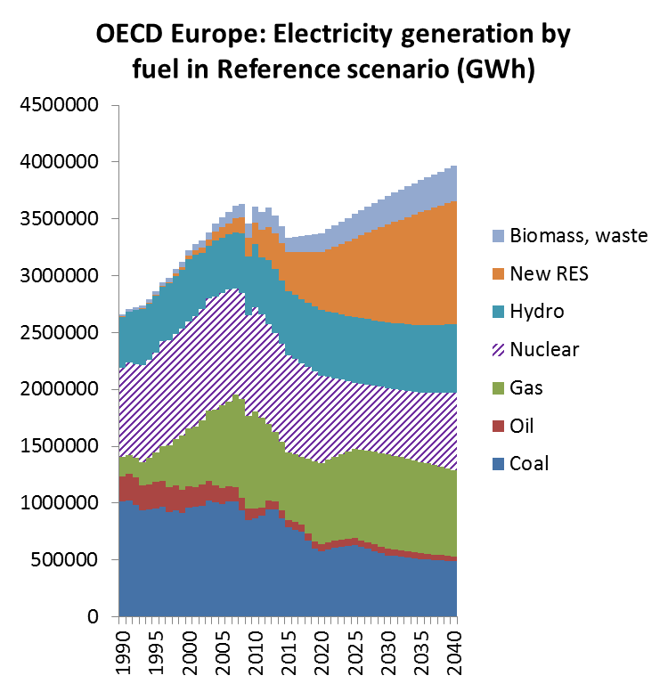
Scenario results
Source: IEA (history), Statoil (projections)

Slide 8
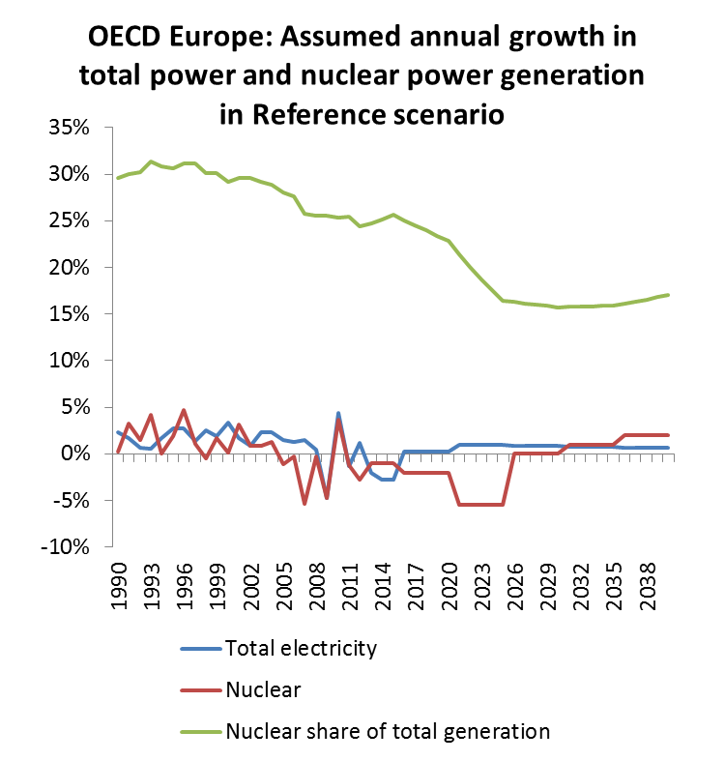
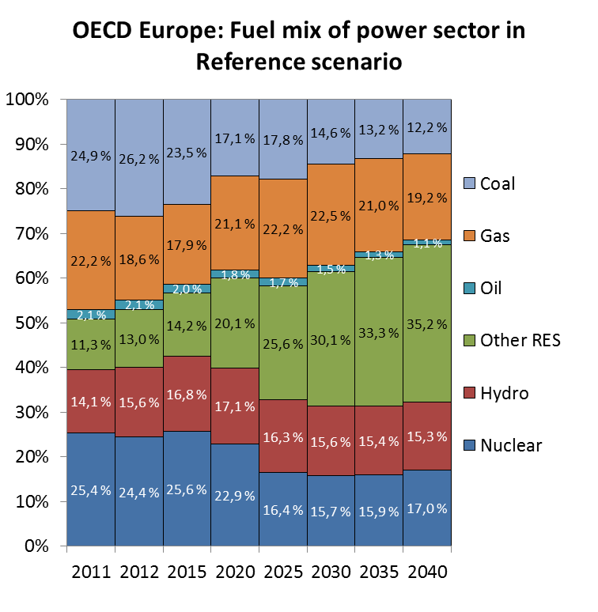
A moderately favorable outlook for nuclear does not imply an expectation of stagnation in renewables!
Source: IEA (history), Statoil (projections)

Slide 9
Presentation title
Presenters name
Presenters title
E-mail address ……@statoil.com
Tel: +4700000000
www.statoil.com

