Slide 1
CREE Site Visit Oslo, September 19, 2013
Who Should Pay for Transmission?
Nils-Henrik M. von der Fehr

Slide 2
Background
Large investment in European transmission networks in coming years
expansion of renewables
system security and reliability
interconnecting different countries and regions
But, who should pay?
network users vs. tax payers
users in different countries
households vs. industry
electricity consumers vs. electricity producers

Slide 3
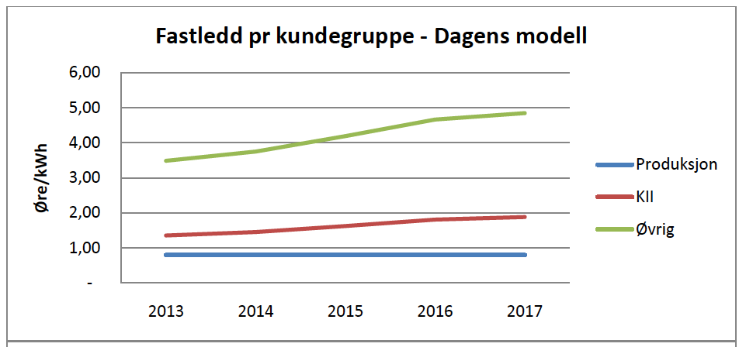
Norwegian Central Grid Tariffs
Source: Statnett, 2010

Slide 4
Optimal Tariffs
Raising sufficient revenues, taking account of how tariffs affect use of network
Two issues
price signals for efficient use of existing capacity
additional tariffs to ensure sufficient revenue
Goal: maximise economic value added
consistent with current regulation
fairness not an issue!

Slide 5
Efficient Use of Existing Capacity

Slide 6
Ensuring Sufficient Revenue
Tariffs for efficient use of existing capacity are insufficient to cover all network costs
Cost coverage requires higher tariffs or new tariff elements
Challenge: to do this with minimum distortion to network use
Principles
tariff base as broad as possible
higher rates on inflexible (inelastic) usage

Slide 7
Consumption versus Production
Network tariffs typically levied on both electricity consumers and electricity producers (generators)
What is the optimal distribution?
efficient price signals
raising revenues efficiently
Tariffs on producers will (partly or fully) be passed through to electricity prices
higher costs means higher prices

Slide 8
Tariff Incidence

Slide 9
Nominal versus Actual Payments
The tariff incidence analysis is independent of on which side of the market the tariff is levied
implies that it is immaterial where tariff is levied
who pays depends on demand and supply conditions
Result modified with interconnection and trade
incomplete pass-through
But, different tariffs in different countries distort competition and leads to productive inefficiency
cf. harmonisation of tariffs in Europe

Slide 10
Efficient Electricity Generation
Indirect taxation leads to inefficiency
distortions between different types of production
Example
generator with fixed unit capital costs f, variable unit costs v and operation time T, and tariff t
average unit costs:
with tariff on capacity:
with tariff on energy:
So, efficiency arguments for covering costs with tariffs on consumers, rather than on generators

Slide 11
Conclusion
Network tariffs affect network utilisation
Should be taken into account if goal is economic efficiency
Tariffs should be set so as to optimise network utilisation, taking account of the need to raise sufficient revenue
Efficiency arguments for raising revenues from consumers, rather than generators

